Slide 1
SPP400 Sprint 1 Review

Slide 2
Discussion of Successes (Retrospective)
Good initial estimation of sprint backlog capacity
Workload was divided in a way that allowed for minimal interdependencies
Assumptions that we had been working on matched with Dr. Horwitz vision for the application.

Slide 3
Discussion of Failures (Retrospective)
Meeting minutes often forgotten about until post meeting, and lacked protocol
Code reviews were not frequent enough, burndown rate was affected
Working on the project wasn’t consistent enough, leading to most issues being backloaded
SCRUM meetings were inconsistent due to this
Research was done during the sprint rather than before
Lack of accountability for the first week of the sprint
Lack of BDD testing

Slide 4
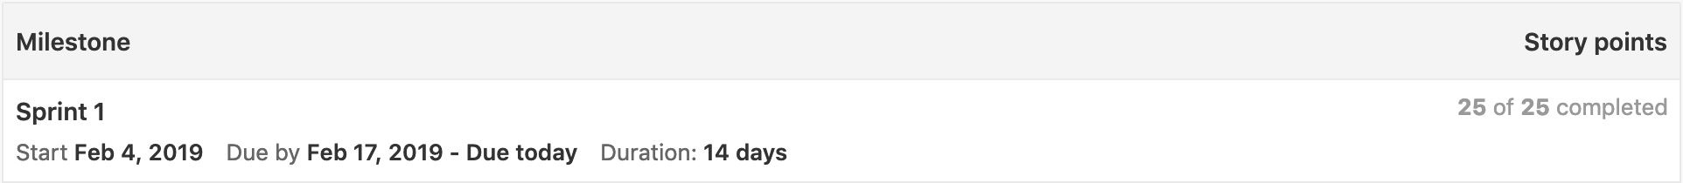
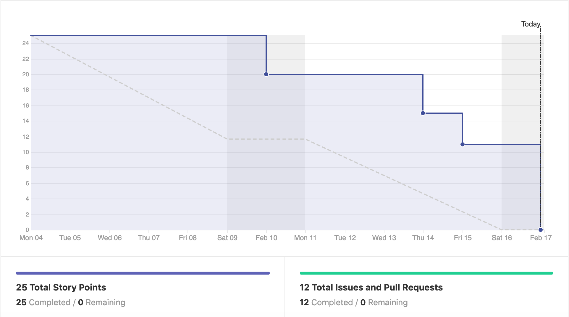
Velocity and Burndown Report

Slide 5
Changes for Sprint 2 (Retrospective)
Focus on writing BDD tests going forward. We will be using the behave-django module and FactoryBoy for testing scenarios.
Increase our number of Meetings (both in person and virtual) and keep better track of Meeting Minutes.
Pull Request response time needs to be faster so that our burndown rate matches the rate at which work is actually completed. We are aiming for a pull request to have 2 reviews within 24 hours of the request being made.
Get in contact with the nurses to work out details with the procedure flows.

Slide 6
Review of Accomplishments
Code coverage currently at 92% across project (Goal is 70%)
All issues completed
Medical procedure flow infrastructure built
Configured deployment using Beanstalk and AWS
Stayed close to our expected velocity
Met with Dr. Horwitz to identify expectations

